Slide 1



1 / 4
Python × NumPy × Pandas × Matplotlib
Matplotlib Mastery
From Data to Visual Insights
Asian Conflict & Security Dashboard
(2000 – 2017)
111,855 Incident Records
ANALYZE / VISUALIZE / MAKE SENSE

Slide 2





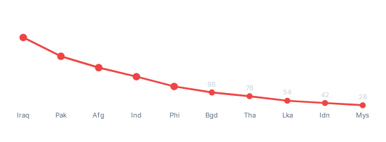
THE DASHBOARD
2 / 4
A 4-panel visualization of security trends across the top 10 most impacted Asian nations using GTD data.
TOTAL ATTACK VOLUMES (TOP 10 ASIAN COUNTRIES)
TOTAL FATALITIES (TOP 10 ASIAN COUNTRIES)
Iraq
16,309
Iraq
52,306
Pakistan
12,472
Pakistan
32,715
India
10,842
Afghanistan
28,421
Afghanistan
9,583
India
21,583
Philippines
6,762
Philippines
14,672
Thailand
5,406
Syria
12,904
Bangladesh
4,231
Thailand
9,875
Sri Lanka
3,892
Bangladesh
7,662
SUCCESSFUL VS. FAILED/PREVENTED ATTACKS
TOTAL SUICIDE ATTACKS (TOP ASIAN COUNTRIES)
IraqPakistanIndiaAfghan.Philip.Others

Slide 3









DATA PIPELINE & WORKFLOW
3 / 4
From raw data to a fully visualized dashboard — using Pandas, NumPy, and Matplotlib.
GUI
Raw GTD Data
Pandas
NumPy
Matplotlib
Dashboard
(111,855 rows)
(Cleaning & Filtering)
(Numerical Processing)
(Visualization)
(Insights)
Data Ingestion & Cleaning
Numerical Processing
Multi-Plot Layout
Export & Presentation
(Pandas)
(NumPy & Pandas)
(Matplotlib)
(Matplotlib)
•
Loaded 111,855 records
•
Computed totals, ratios, & suicide counts
•
2 × 2 grid with subplots
•
Saved as high-resolution images
•
Filtered Asian regions (South, Southeast, East, Central, MENA)
•
Bar, horizontal bar, grouped bar & scatter plots
•
plt.savefig(..., dpi=300)
•
Used NumPy for array operations & grouping
•
Publication-ready visuals
•
Handled missing values (fillna)
•
Object-Oriented approach
•
Prepared data for plotting
Better Data → Better Decisions

Slide 4










WHAT I LEARNED
4 / 4
Built a strong foundation in data visualization and analysis — and I'm just getting started.
Matplotlib Concepts
Data Analysis Skills
The Journey So Far
• Introduction to Data Visualisation
• Data cleaning & missing values
• Figures, Axes, Axis, Ticks, Spines
• Data transformation & filtering
• Grid, Legend
• String operations (.str)
• Pyplot & its functions
• GroupBy & aggregation
• Bar, Pie, Histogram, Scatter plots
• Merging, joining & stacking
• Subplots & layout adjustments
• Categorical encoding
• Saving figures (PNG, JPG, PDF)
• Memory-efficient workflows
• Git for version control
Next Stop: EDA → Machine Learning
Same journey, Bigger goals.

